Slide 1


Capewell Solid-State Timer
Team 9:
ME: Patrick Dunham and Joshua Reinhart
EE: Patrick Meres, Robert Endrizzi, Nicole Hershman, and Jaileen Algarin
Faculty Advisors: Dr. Rajeev Bansal & Dr. Thanh Nguyen
Sponsor Representative: Andrew Smith
Notes:
Patrick

Slide 2
Presentation Outline
Project Requirements
Current Standing
Microcontroller (MCU)
Relays
Power Supply
User Interface (UI)
Mounting Platform
Schedule
Moving Forward
Notes:
Josh

Slide 3
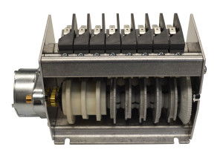
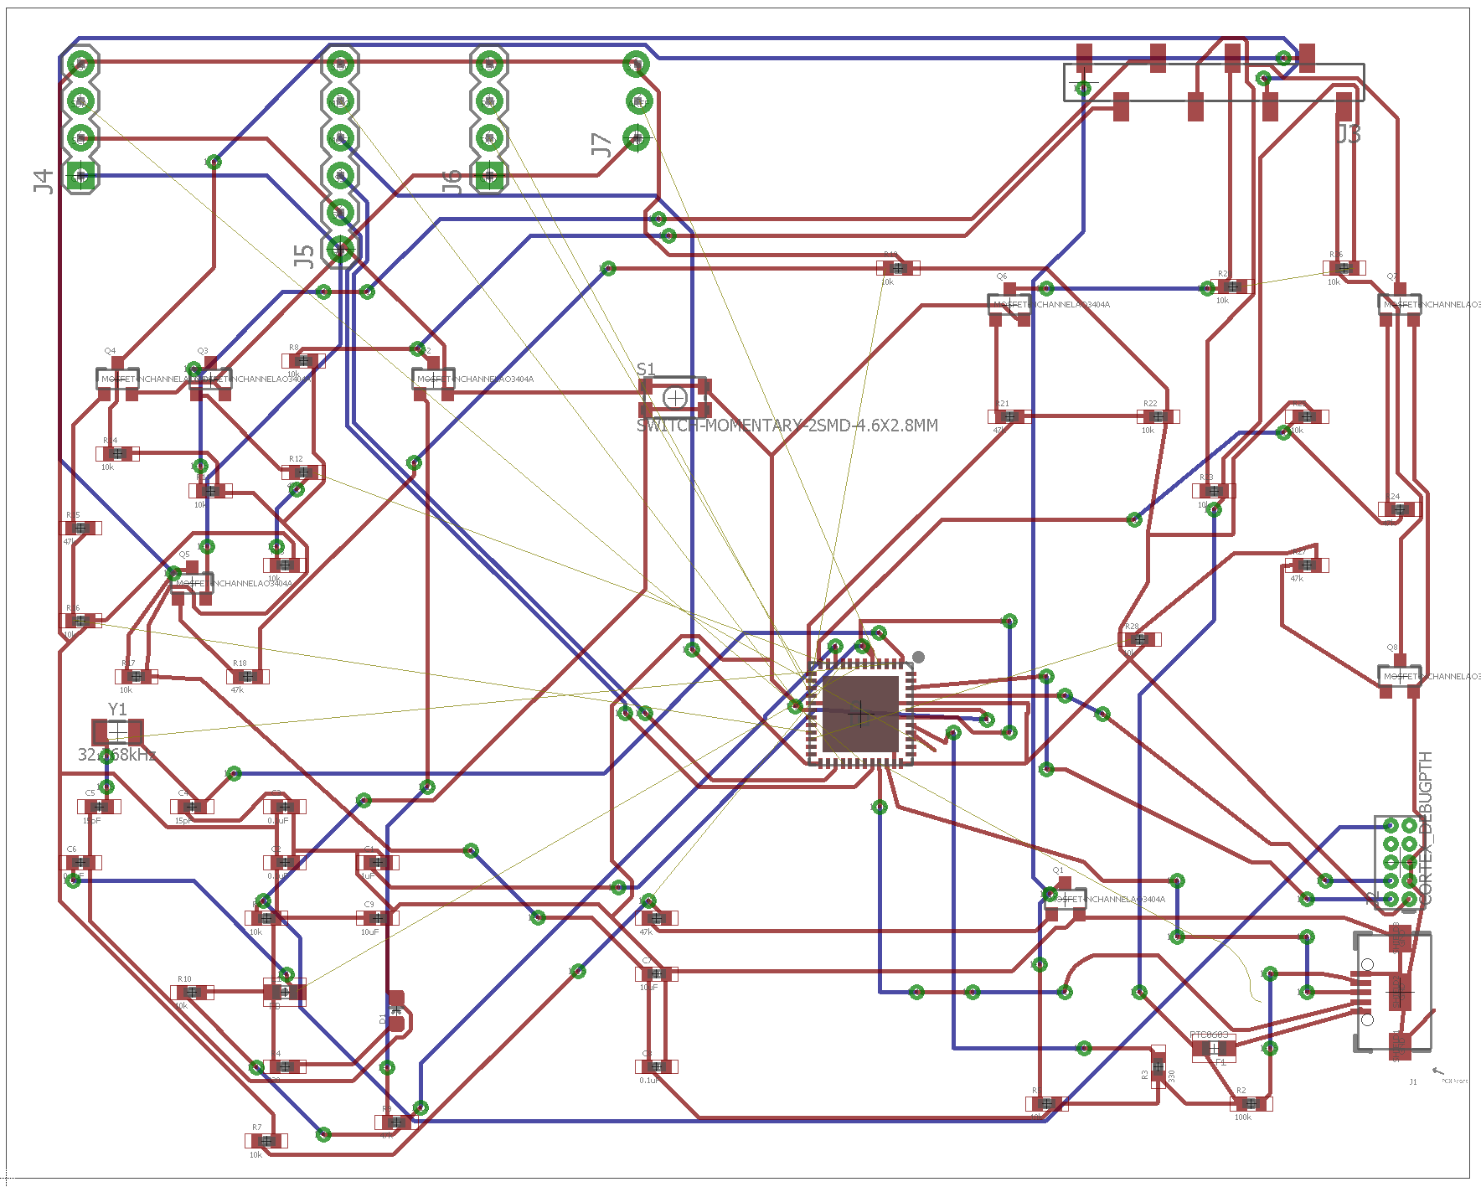
Project Requirements
Redesign C10B Electromechanical Cycle Timer
Match current timer in size and function
Completely solid-state design
Deliverables: Solid-State Timer Design & Source Code
PCB Design/Schematic
Mounting platform CAD Files
Microcontroller Source Code
Working Prototype
Switches
2.72”
3.3”
5.6”
Motor
Cams
Solid-State Timer PCB
8-Cam C10 Cycle Timer
About Capewell
Notes:
Josh

Slide 4
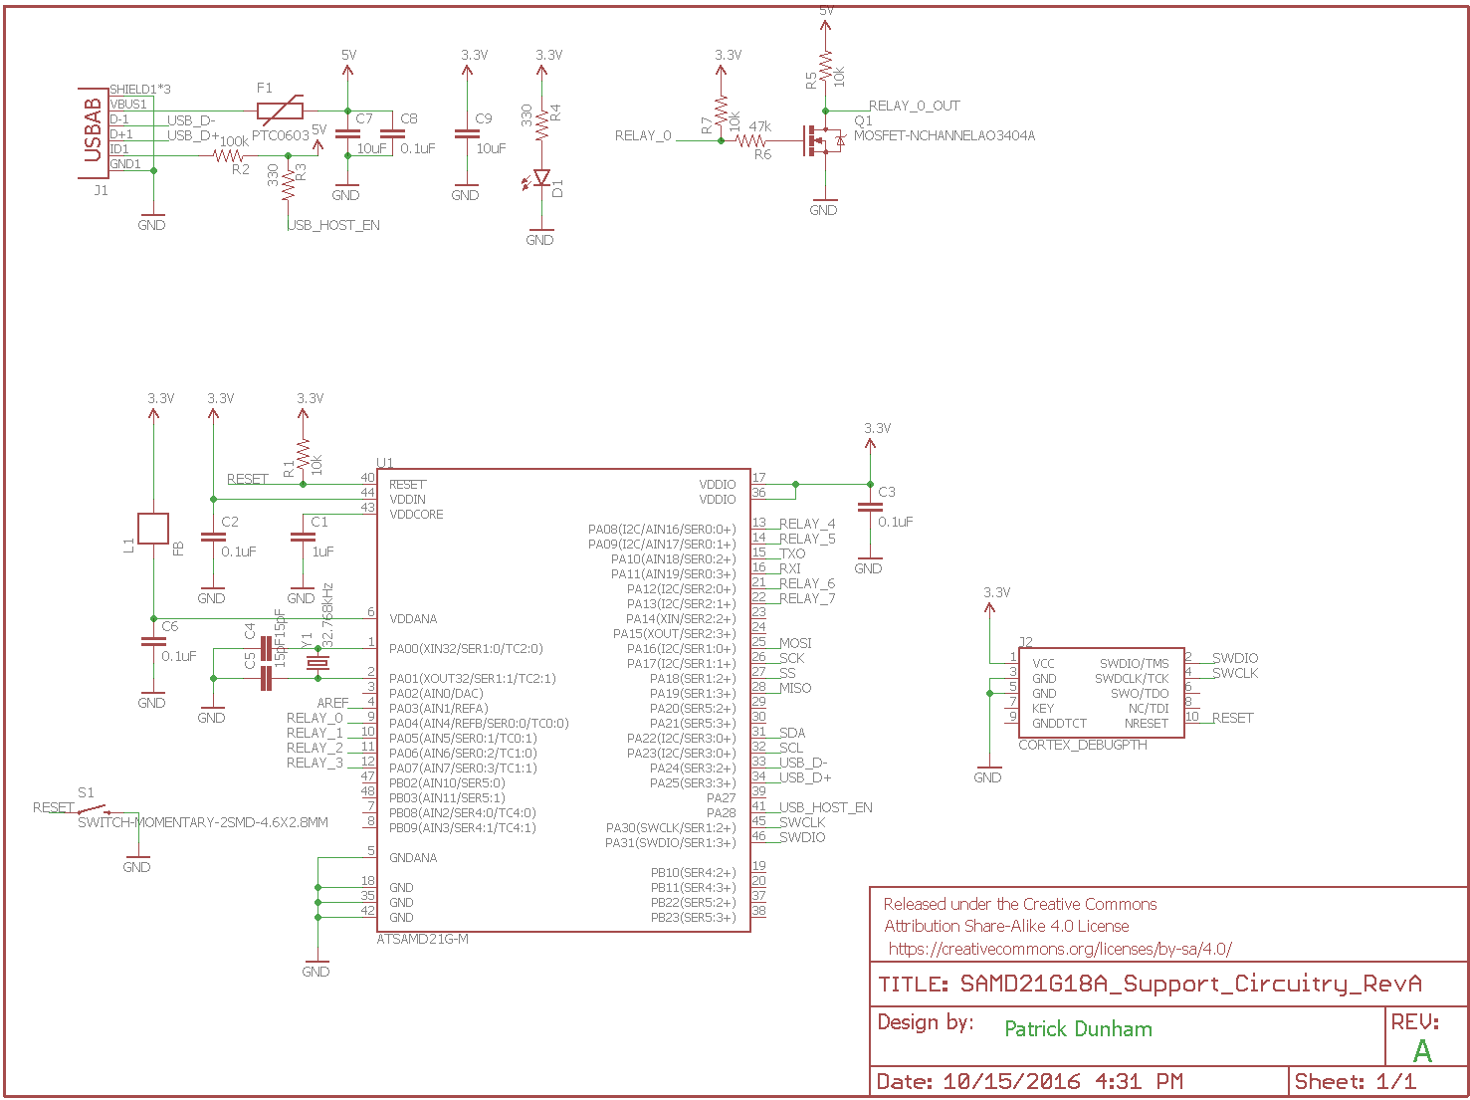
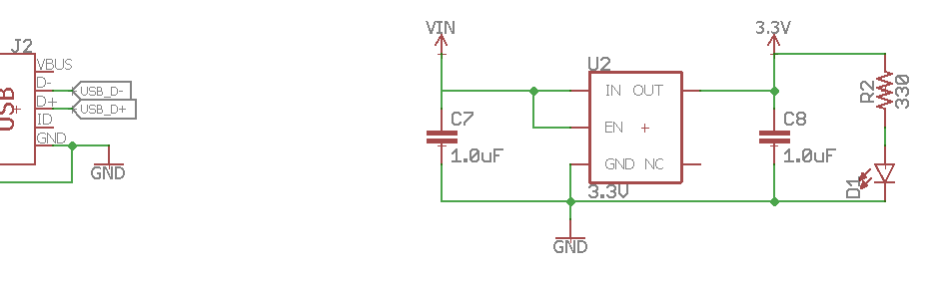
Microcontroller: Schematic
USB Connector
Relay Controller (x8)
Microcontroller
Notes:
Patrick

Slide 5
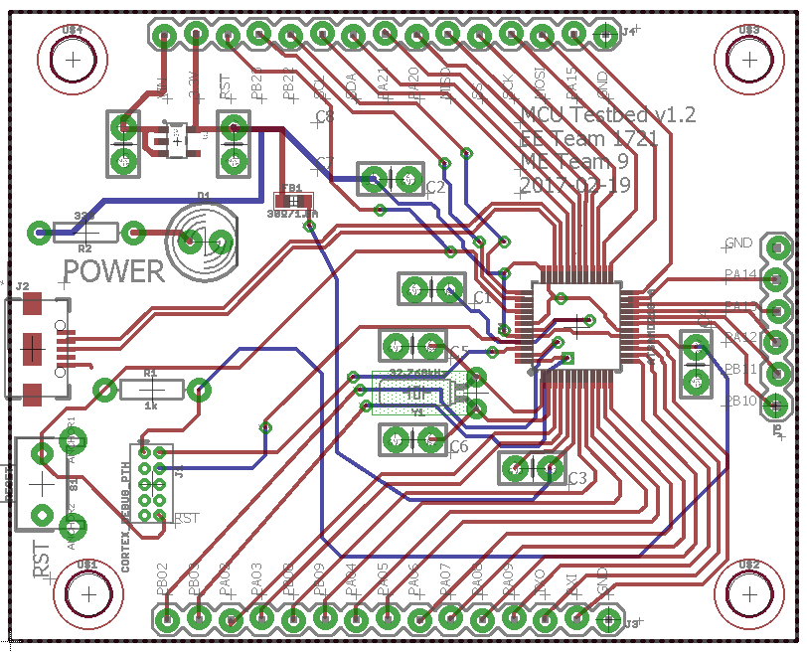
Microcontroller: Board Design
2.0”
2.5”
Current Prototype
Notes:
Patrick

Slide 6
Microcontroller: Board Design
Power
USB
2.0”
Programming
Microcontroller
2.5”
Current Prototype
Notes:
Patrick

Slide 7
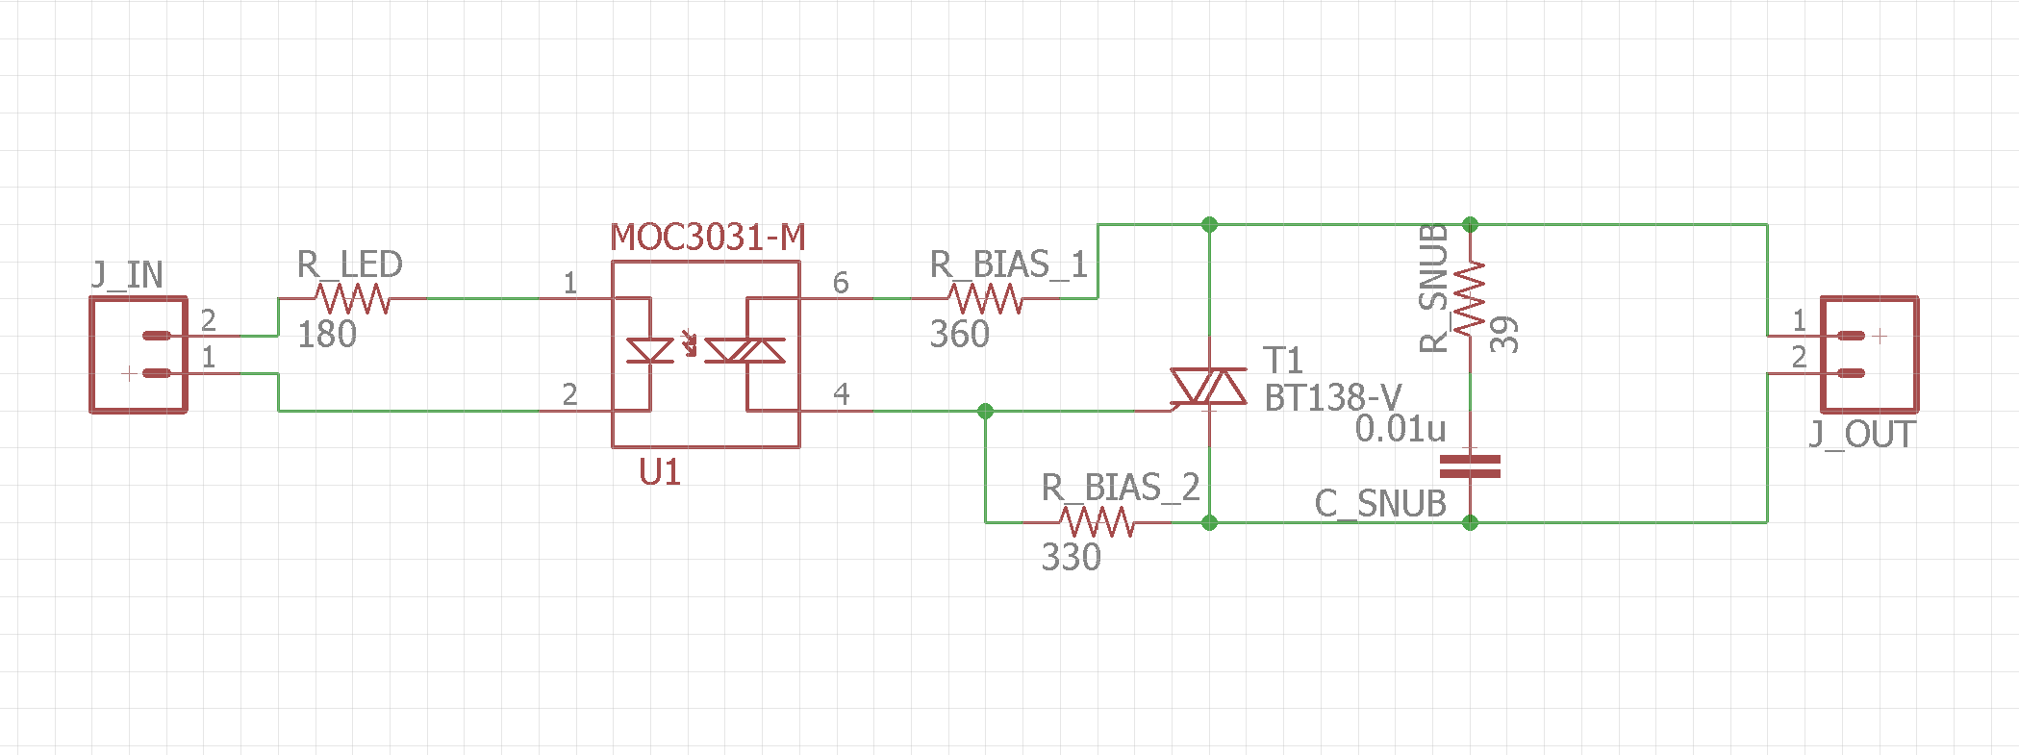
Solid-State Relays: Schematic
Optoisolator
TRIAC
Load
Notes:
Josh
Optoisolator protects circuit from high voltage (120 V from wall)
TRIAC turns on and off high loads, snubber circuit makes sure TRIAC turns off
Load connector used to connect to whatever we’re powering
Essentially, this is an electrically controlled SPST (Single Pole, Single Throw or Closed/Open) switch

Slide 8
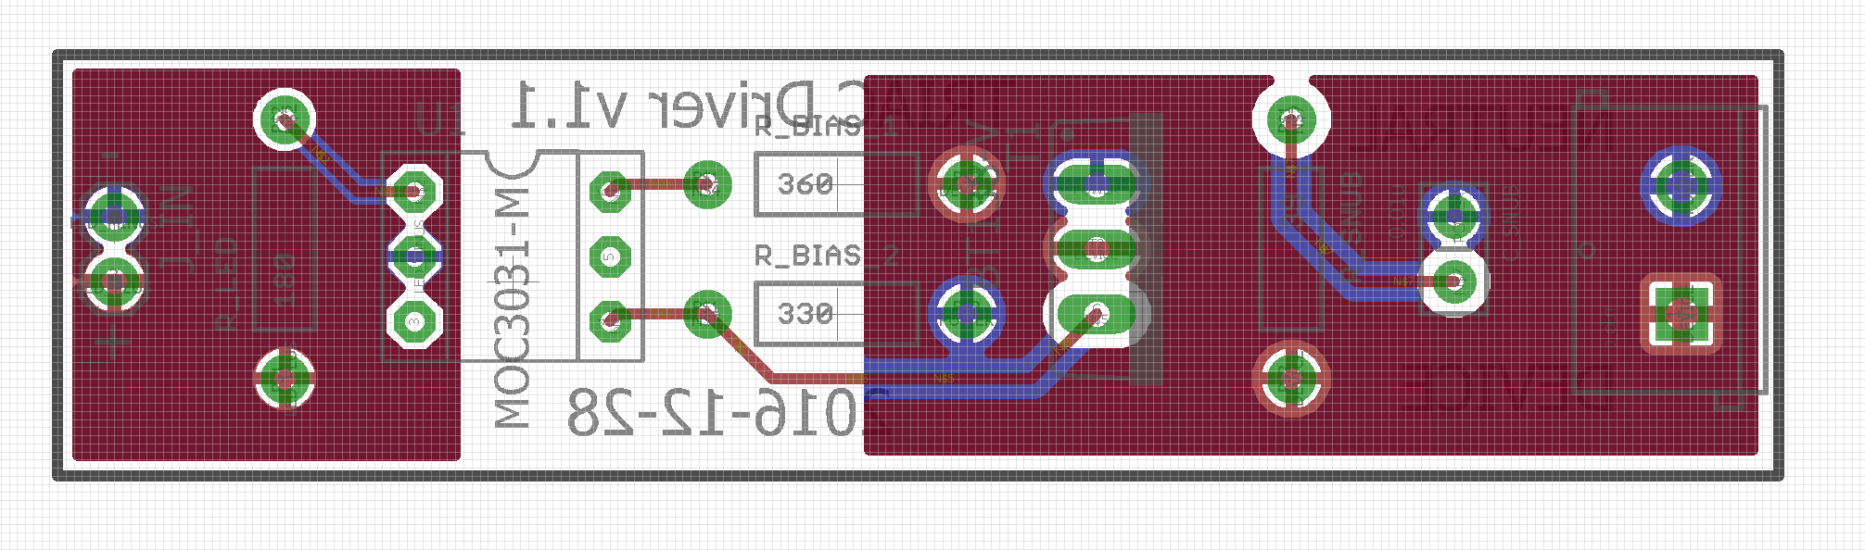
Solid-State Relays: Board Design
Notes:
Josh
This is the PCB – next slide!!

Slide 9
Solid-State Relays: Board Design
Optoisolator
Load
TRIAC
Notes:
Josh
This PCB is laid out in the same order as the schematic. Optoisolator to the left, TRIAC near the middle, Load connector to the right
The big red things are PCB copper pours. The left one is a ground plane, the right ones (there’s a blue one under the red one) are to handle high load current

Slide 10
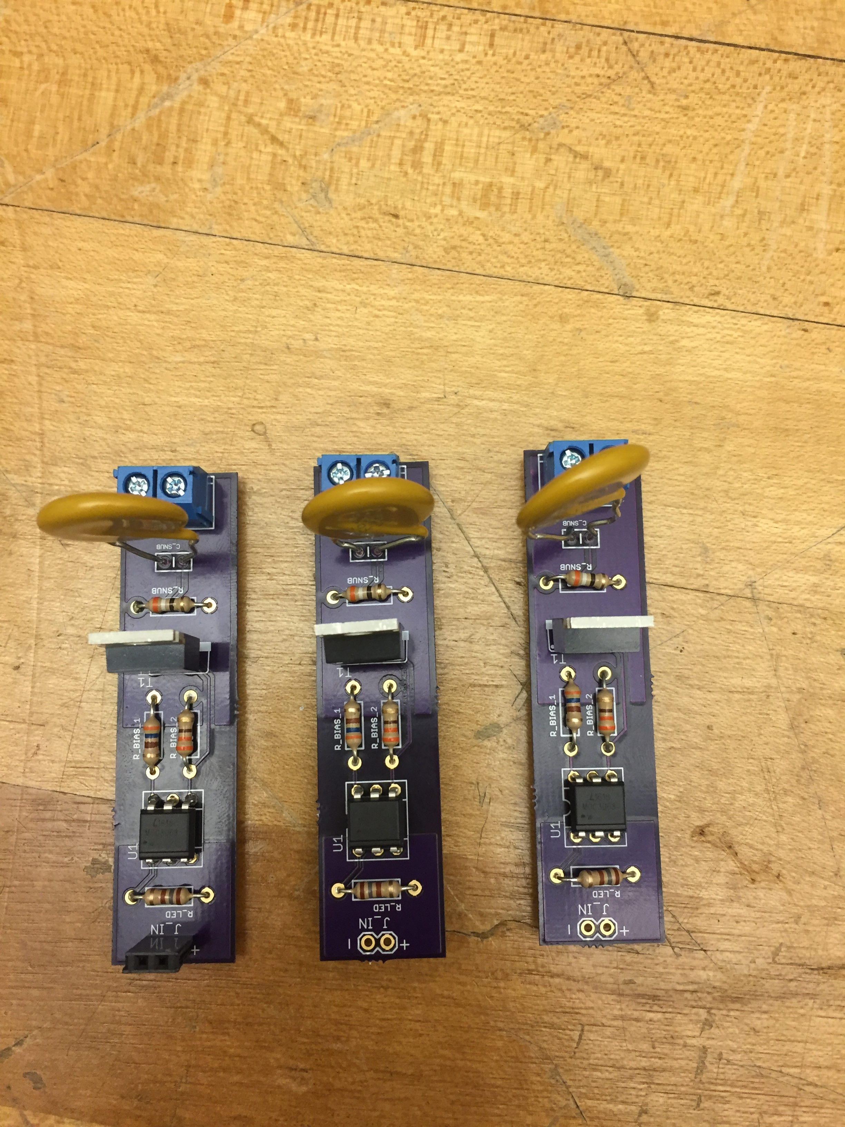
Solid-State Relays: Assembled Board
Load
TRIAC
Optoisolator
Notes:
Josh
Here’s some assembled boards

Slide 11
Solid-State Relays: Simulation Data
Roughly 1 Watt of power must be dissipated per Ampere of current through each relay
Notes:
Josh
Here’s simulation data collected on TRIAC power dissipation versus load current. The trend is roughly linear, and depends very little on power factor
This matches the datasheet!
(side note, the TRIACS are more than 99% efficient)

Slide 12
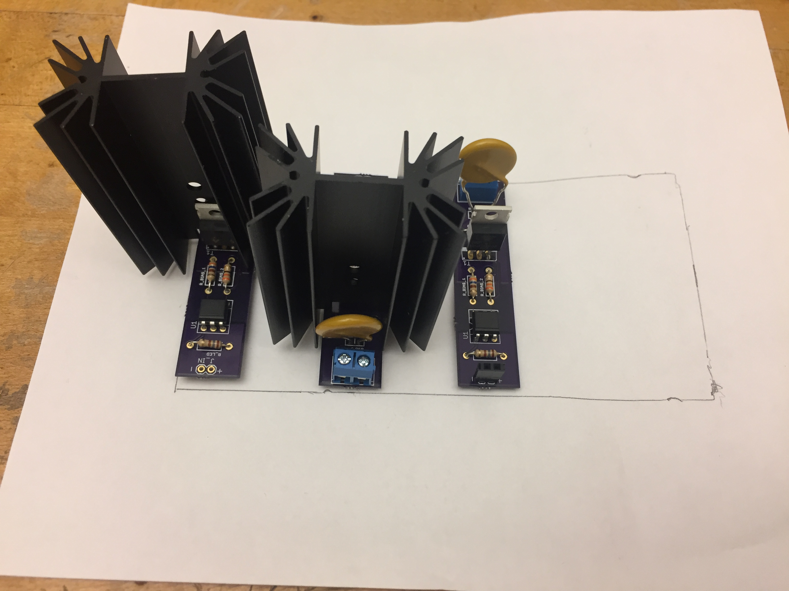
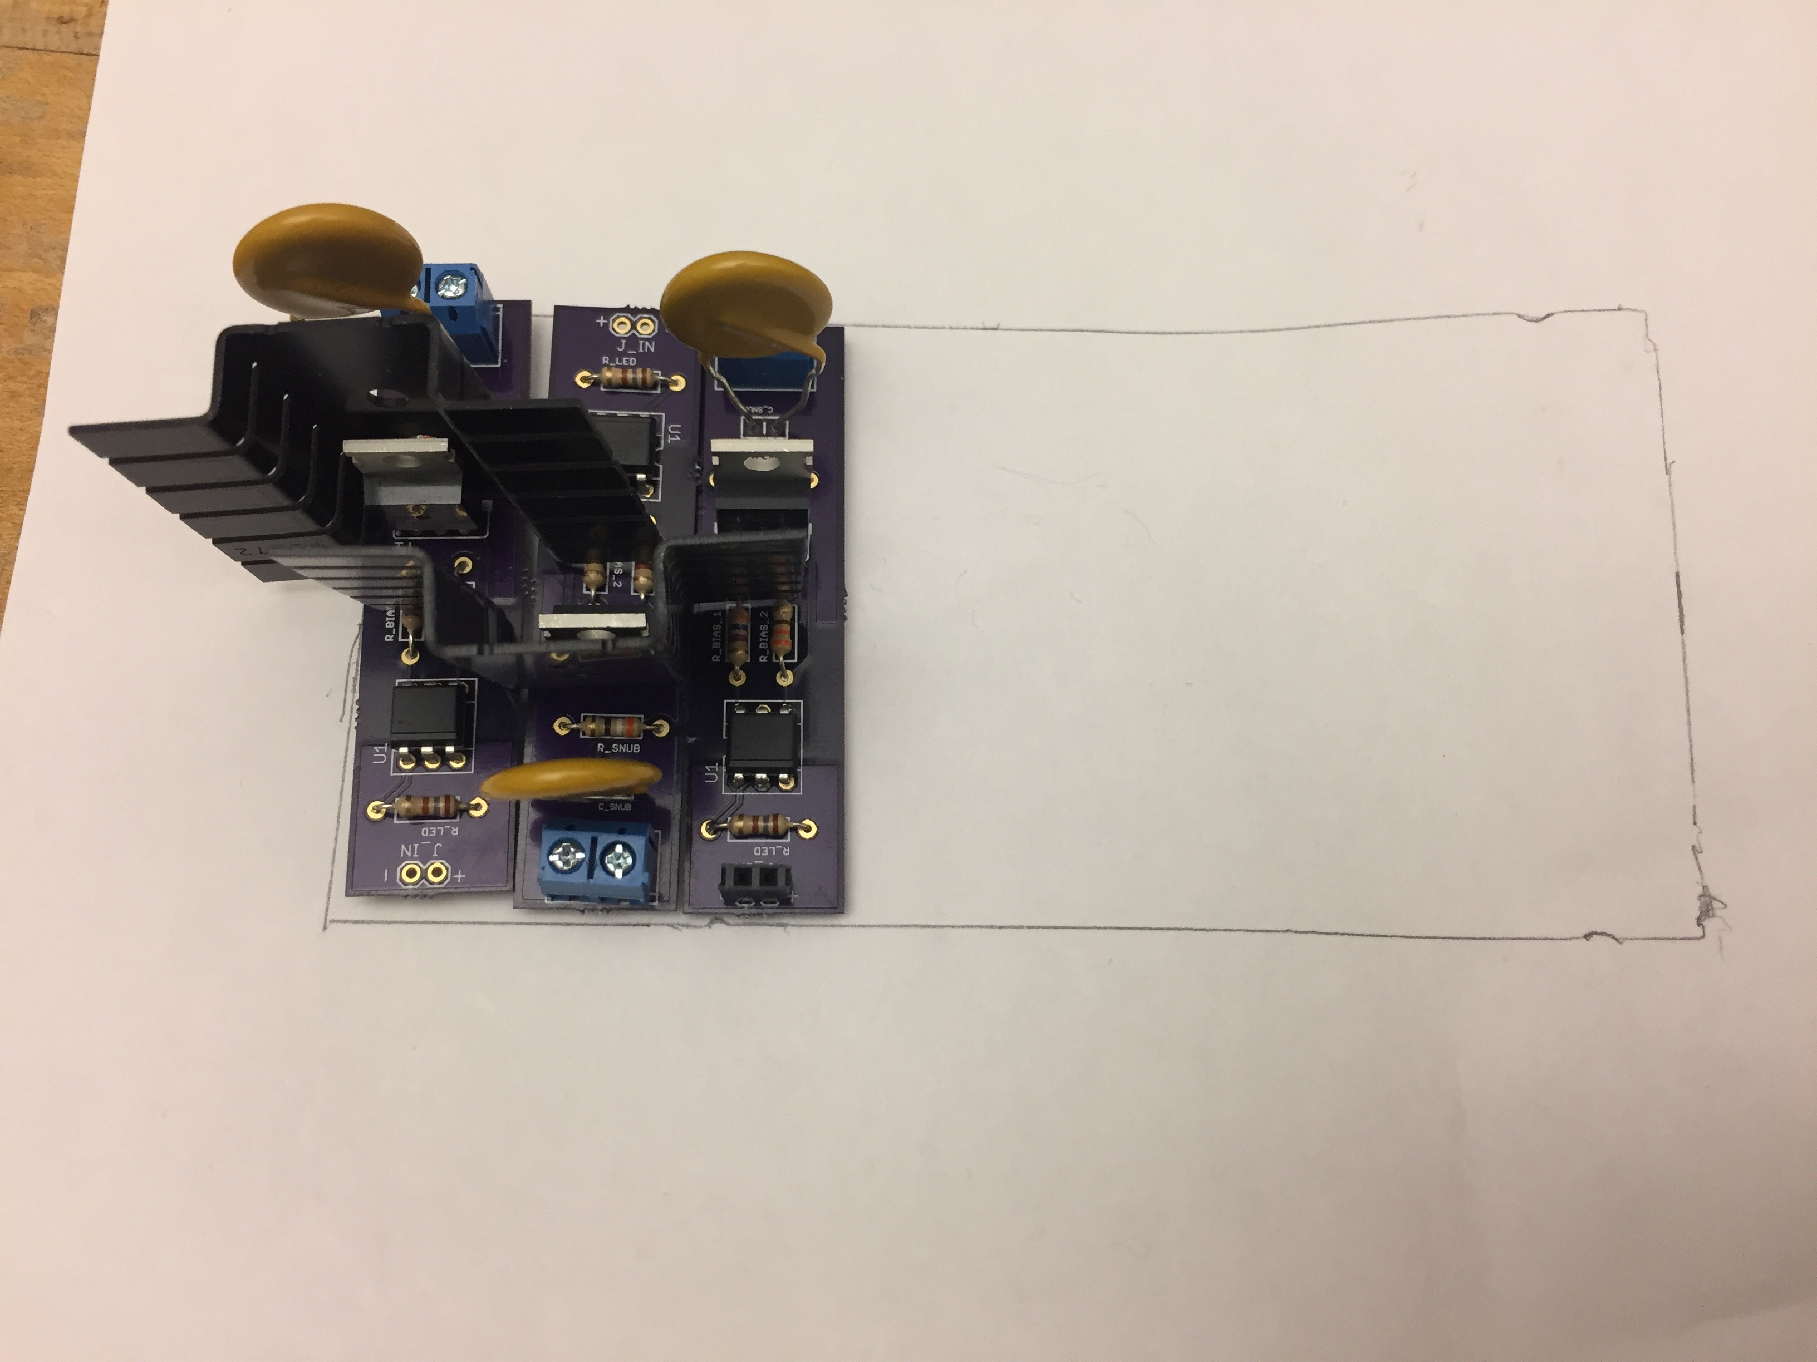
Solid-State Relays: Heat Sinks
At 15 A, 15 W of heat is produced
Ambient Temp = 60 C
Max Device Temp = 150 C
Need heatsink w/ R_{TH}< 3.13 K/W
Reduce relays to 10 A rating
Smaller heat sinks fit closer together
5.6”
2.72”
Heat sinks too big for allotted space
Heat sinks fit with staggered relay redesign
Notes:
Josh
Figure taken from BT139-800E data sheet

Slide 13
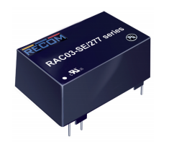
Power Stage: Board Mount Solution
AC/DC Converter
Cost: ~$12
Output Voltage: 5 V
Output Current: .6 A
Power: 3 W
Input Voltage: 85-264 VAC
Power Converter Chip
0.9”
1.5”
Notes:
Patrick

Slide 14
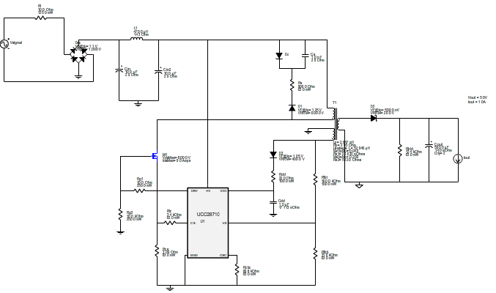
Power Stage: Custom Solution
Multistage Switching Converter: Primary Flyback Converter Schematic
Rectifier
Controller
Flyback Converter
Flyback Converter Basics
Notes:
Patrick

Slide 15
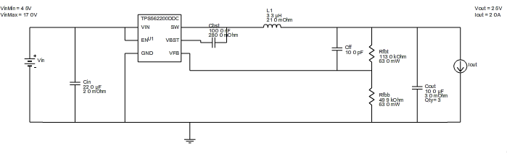
Buck Converter Schematic
Multistage Switching Converter: Secondary Buck Converter Schematic
Buck Converter Basics
Controller/Converter
Notes:
Patrick

Slide 16
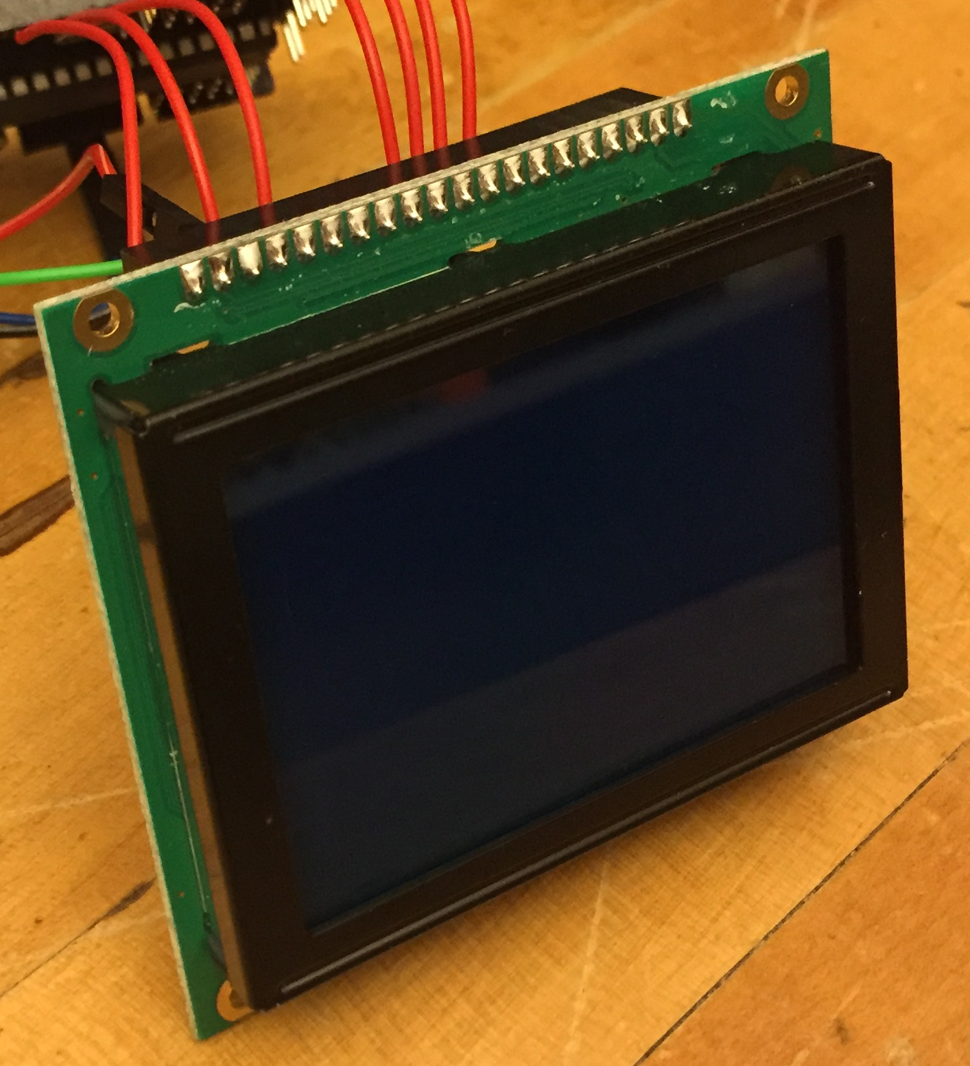
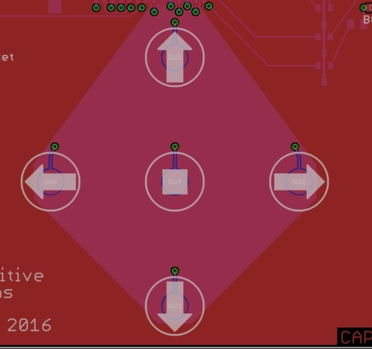
User Interface (UI)
Graphic LCD Screen
128x64 pixel display
Operates in up to 70° C conditions
Interfaces w/ Microcontroller
User control: Capacitive Buttons
Durability, cost, easy, smaller chance of false readings
2.075”
Capacitive Buttons
2.953”
Graphic Display
Notes:
Patrick

Slide 17
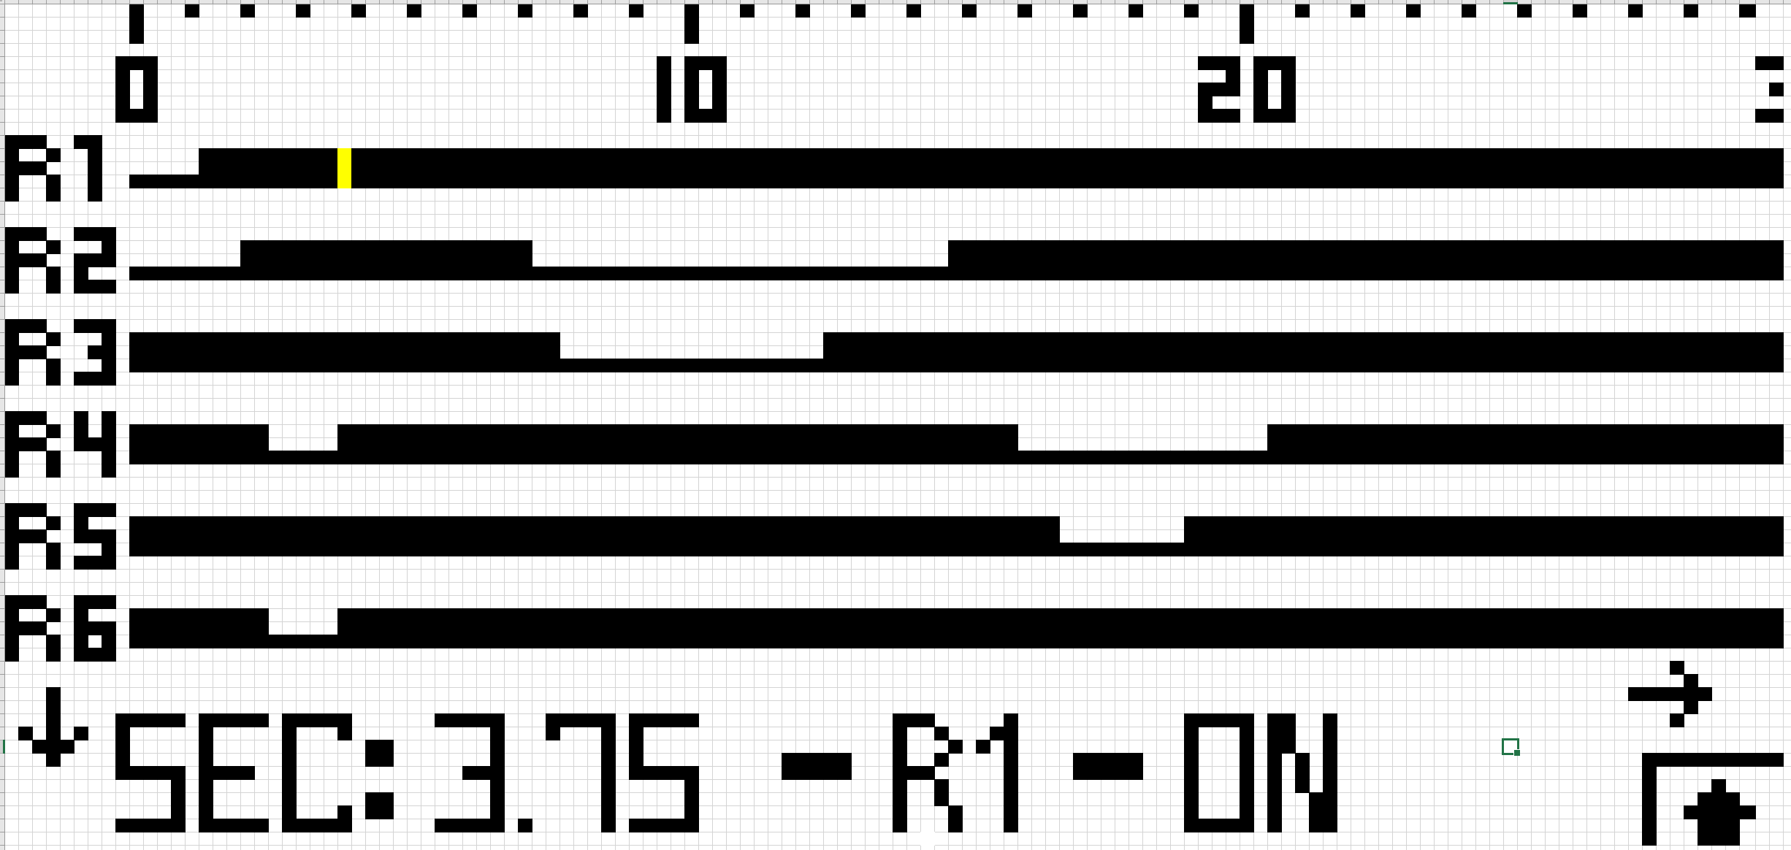
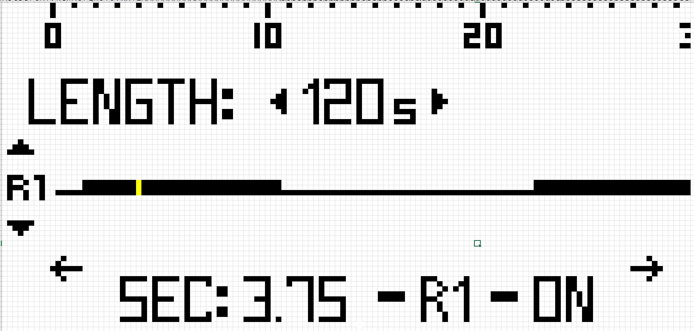
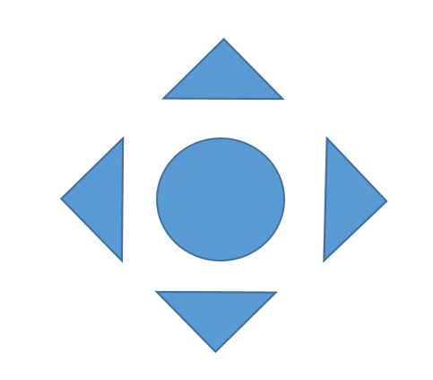
UI: Design
Display for LCD Screen
Timing Diagram
Each Pixel Represents .25 seconds
Button Layout
Notes:
Patrick

Slide 18
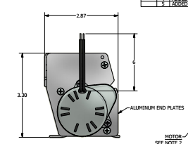
Mounting Platform: Operation
Must match original enclosure footprint
Extruded aluminum
Does not need to be dustproof or waterproof
Concerns are responsibility of customer
Notes:
Josh

Slide 19
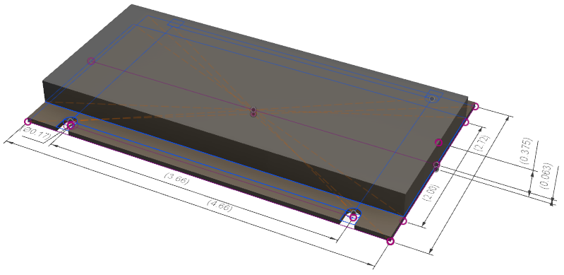
Mounting Platform: Design
Dimensions in inches
Notes:
Josh

Slide 20
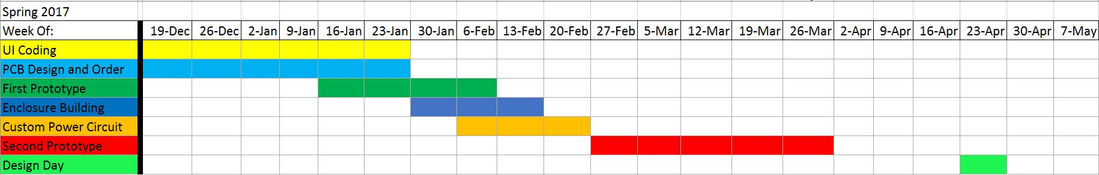
Schedule
Mar. 2 – Custom Power Supply Prototyping Begins
Mar. 5 – Finish and Test UI Coding
Mar. 5 – Testing Relay Operation (Controlled by MCU) With Toaster Oven
Mar. 5 – Redesign All Boards for SMD
Mar. 17 – Test Shrunken Boards and Redesign as Single PCB
Mar. 31 – Test Single PCB. (Redesign if Necessary)
(Apr. 14 – Test Redesigned Single PCB in Necessary)
Notes:
Patrick

Slide 21
Moving Forward
Finish Coding UI
Redesign Component PCBs for SMD, then Integrate
3D Print New Mounting Platform Design
Assemble overall prototype using PCB and Mounting Platform
GOTO: 2
Notes:
Patrick

Slide 22
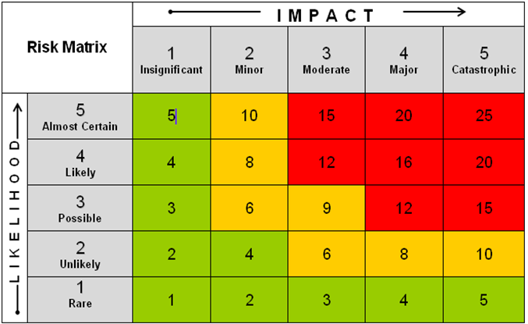
Risk Cube
UI Coding Doesn’t Work
Larger Heat Sinks Fail Original Requirements
Shipping Delays
PCB Mistakes
1
2
4
3
Notes:
Josh

Slide 23
Risk Assessment
UI Coding Doesn’t Work
- UI requires computer & USB connection
Larger Heat Sinks Fail Original Requirements
- De-rate TRIACs to 10A
Shipping Delays
- Rush items, spend more money
PCB Mistakes
- Rush items, spend more money
- No time for more than 2 revisions
Notes:
Josh

Slide 24
Estimated Unit Cost
Estimated cost does not include labor
Item | Cost
MCU | $6
8 Relays | $9
Power Converter | $11
LCD | $10
PCB + Mounting Platform | $5
Total | $41
Notes:
Josh

Slide 25
Team Assessment
Presentation Style
Readability of Slides
Clarity of Project Objectives and Deliverables
Clicker Scoring
A - “I get it” - Clear, Nice Job!
B - “I kind of get it” - Needs More Work
C - “I’m confused” - Needs Lots of Work

Slide 26
Who Is Capewell?
“Capewell Aerial Systems is a global leader in aerospace and life support. We are a respected provider of engineered products for aerial delivery, life support and tactical gear for military, law enforcement and humanitarian agencies worldwide. Founded in 1881, Capewell has thrived by helping customers conceive, engineer, prototype, manufacture and field test products that must perform flawlessly in critical situations.”
Back

Slide 27
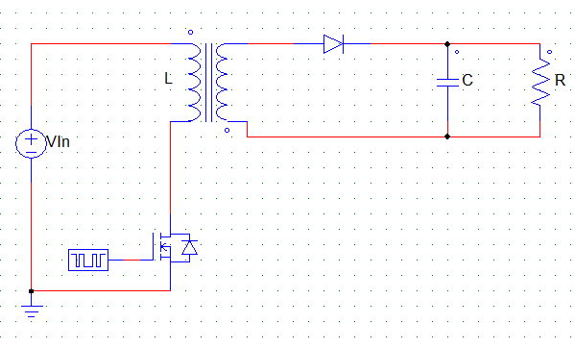
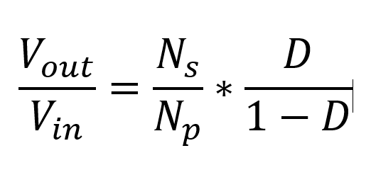
Flyback Converter Basics
Uses inductor, capacitor, and switching device (transistor) to change DC voltage levels. Transformer provides electrical isolation.
Back

Slide 28
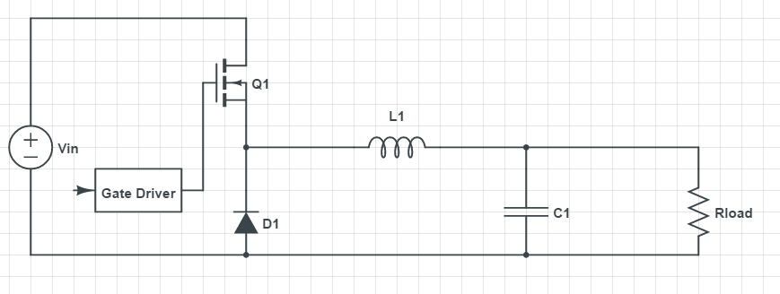
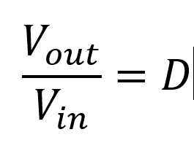
Buck Converter Basics
Uses inductor, capacitor, and switching device (transistor) to change DC voltage levels. Output voltage must be lower than input.
Back

